Slide 1


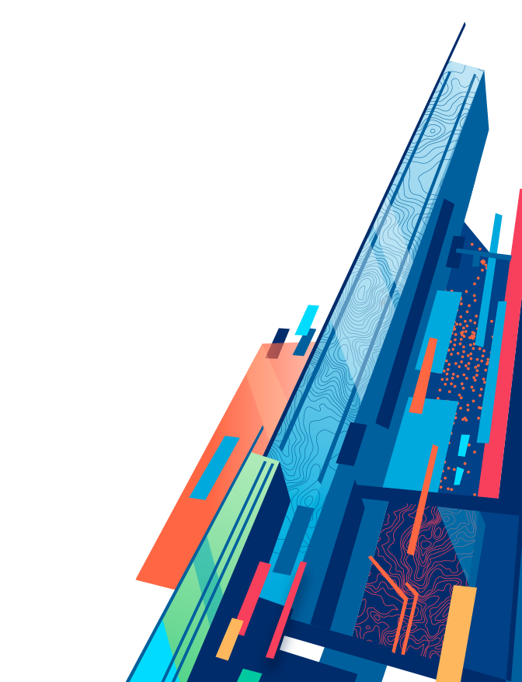


3D Visualization with the ArcGIS API for JavaScript
Kristian Ekenes & Johannes Schmid
Notes:
G97350 UC Template for Esri staff

Slide 2
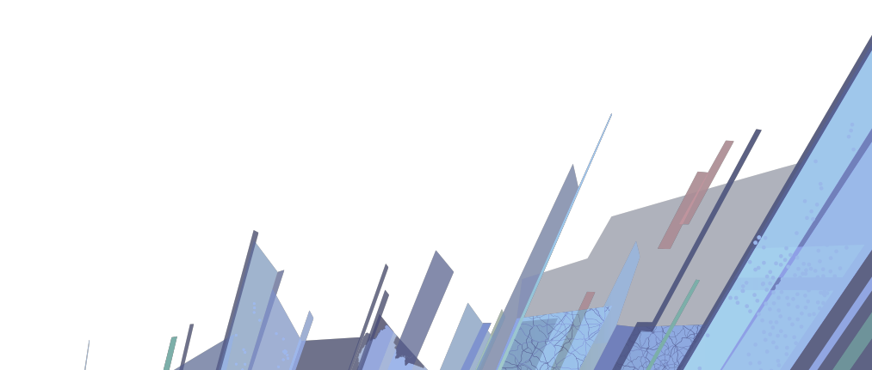
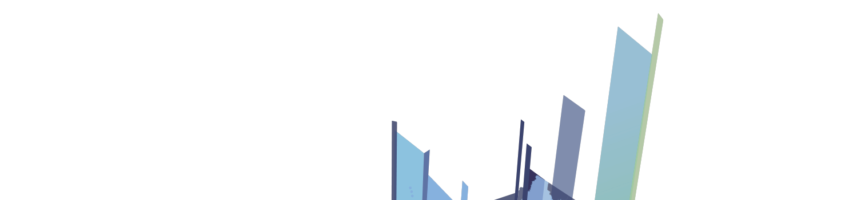
Discover how to visualize geodata in a meaningful way in 3D using ArcGIS API for JavaScript

Slide 3
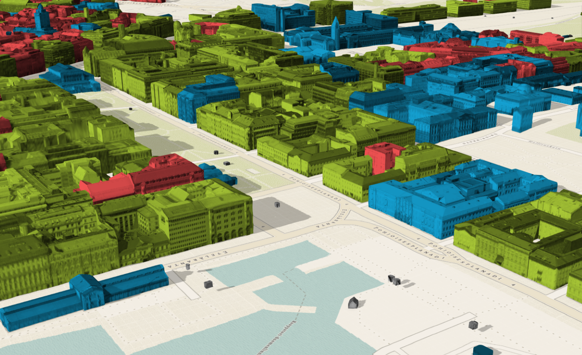
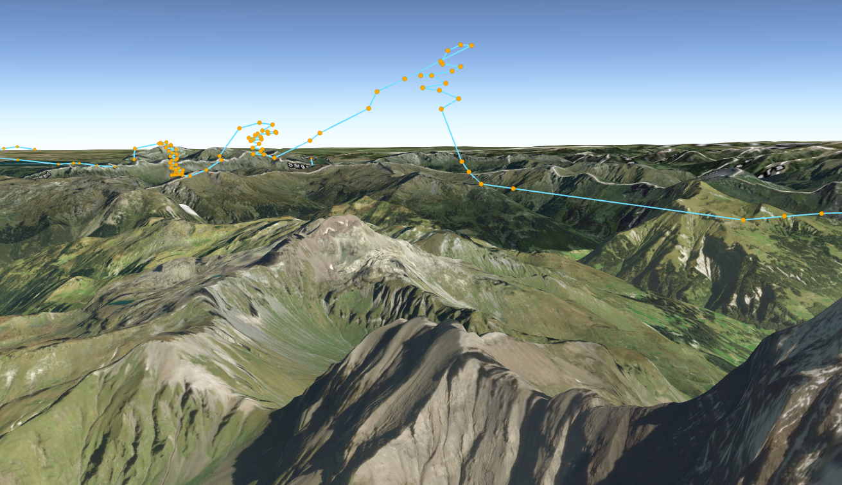
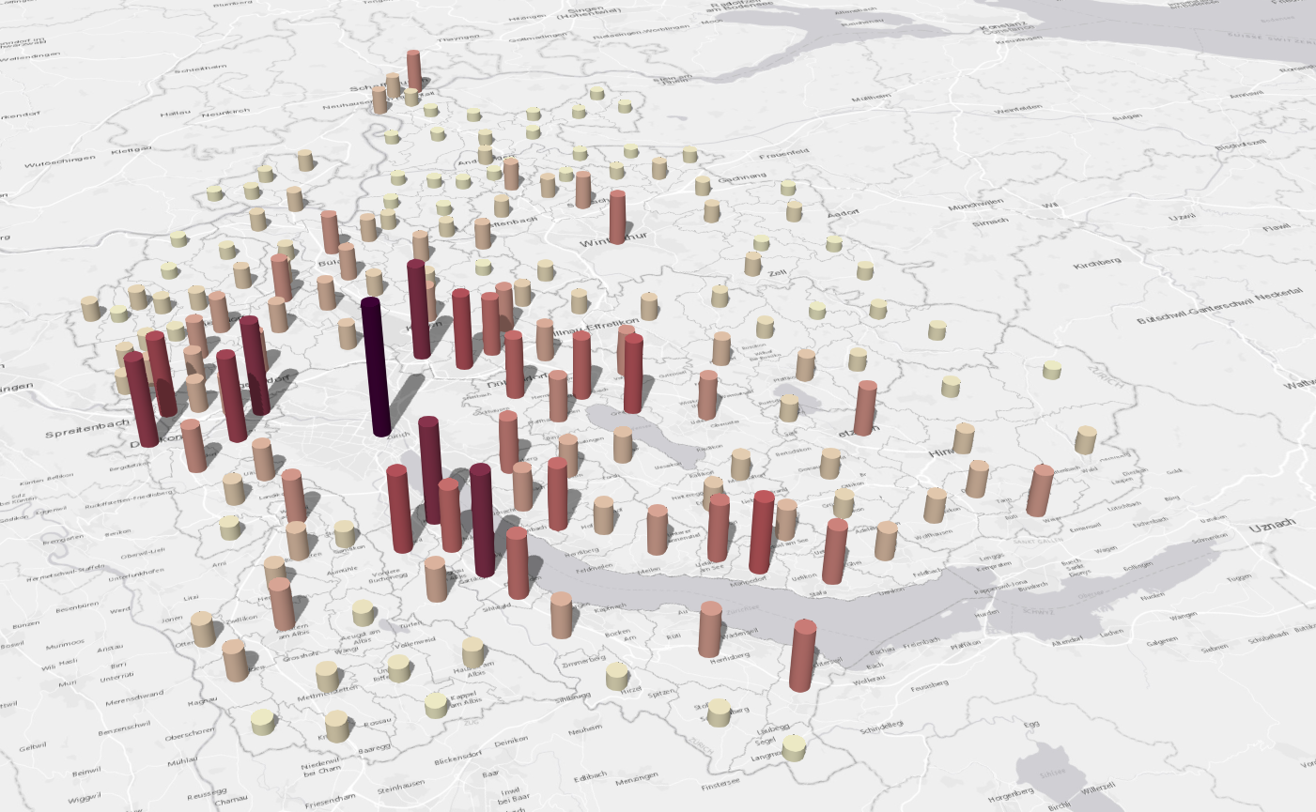
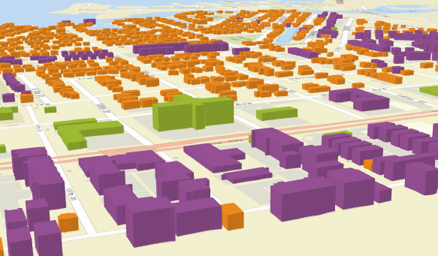
What can you visualize?
Location
Types
Data (numbers)
Combinations of the above

Slide 4
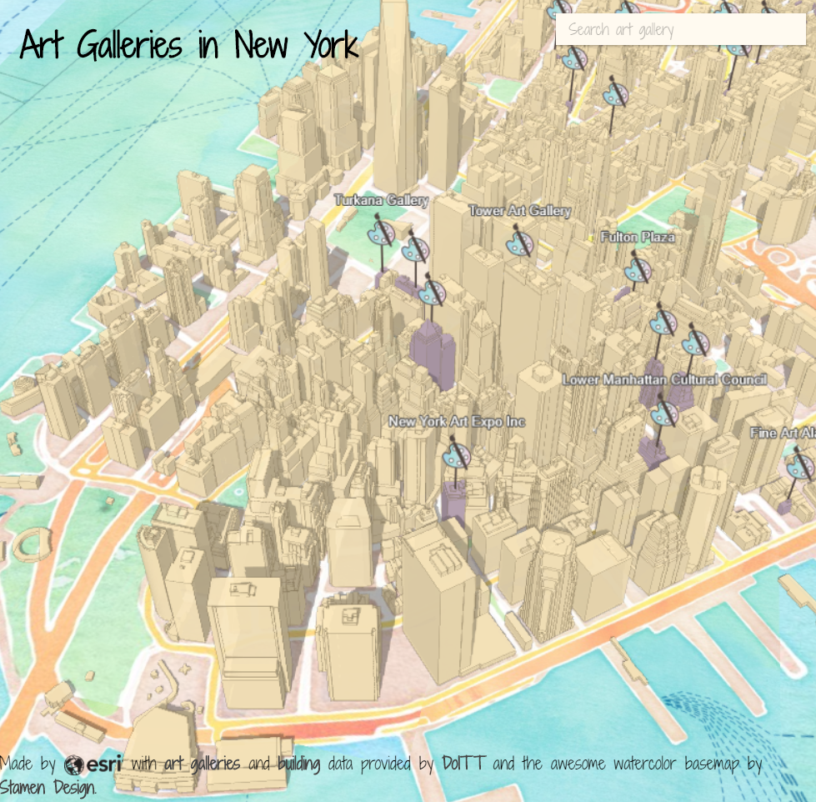
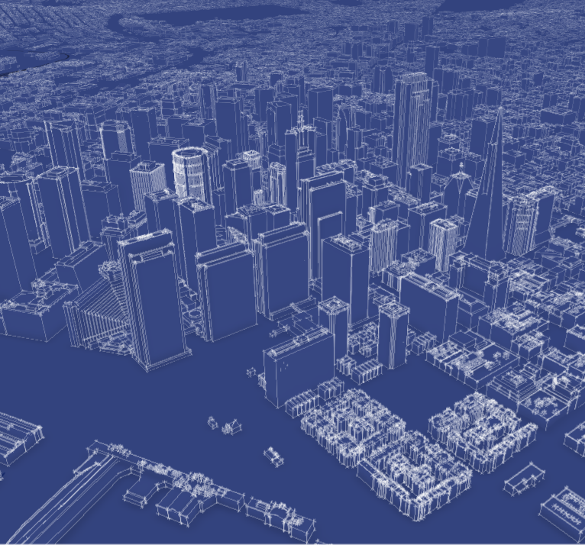
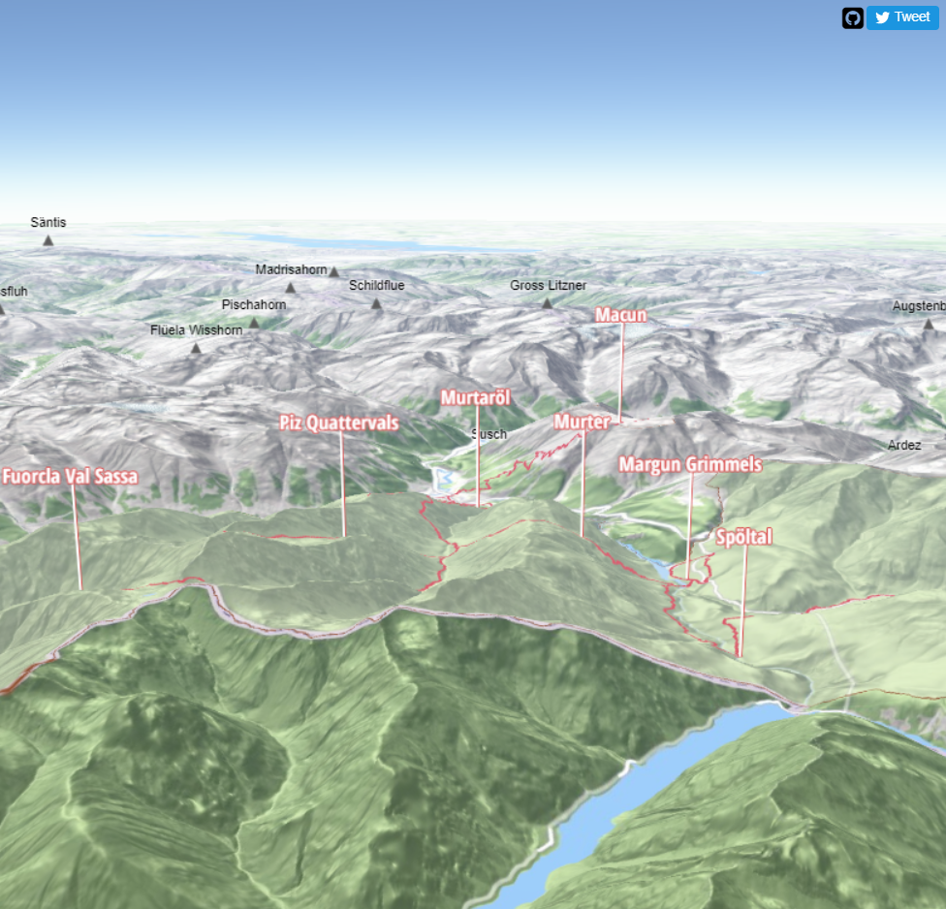
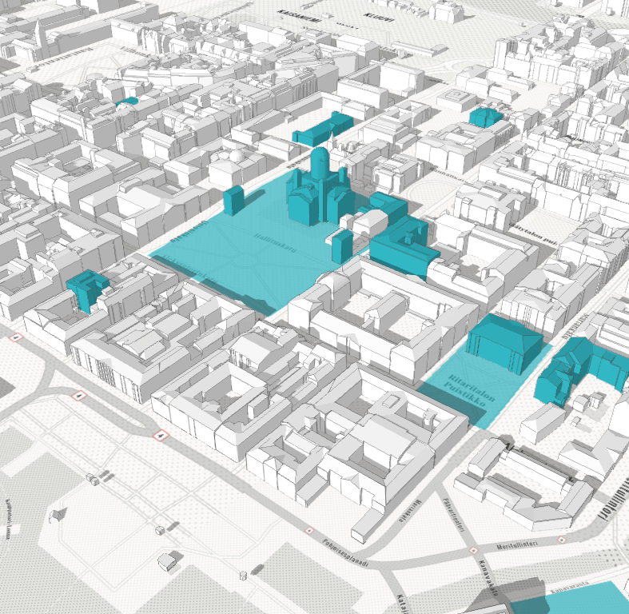
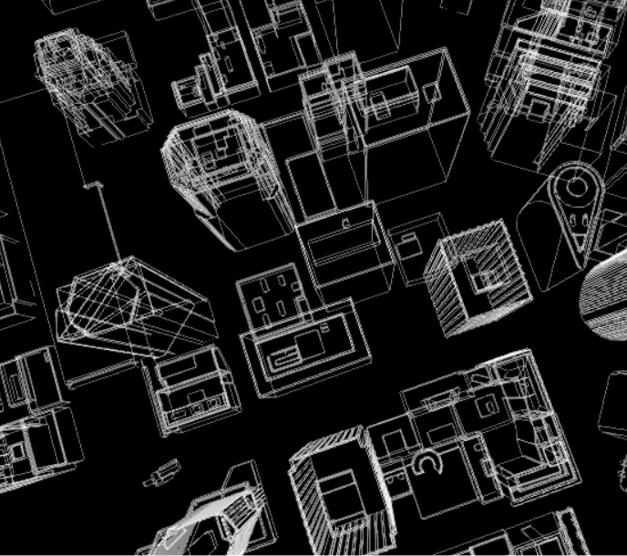
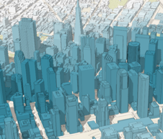
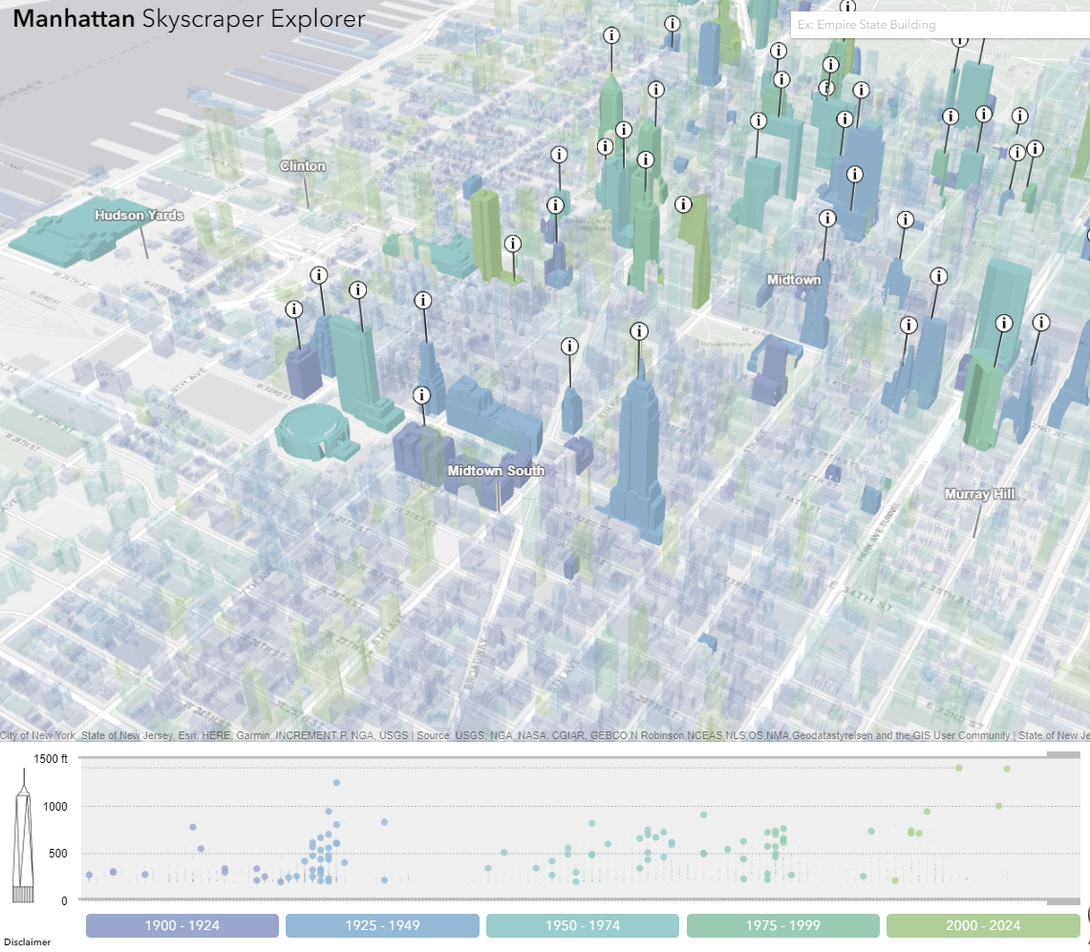
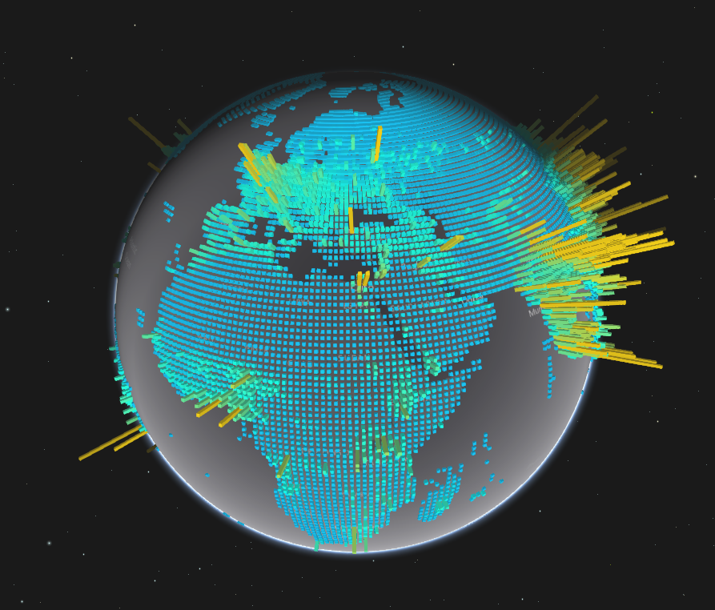
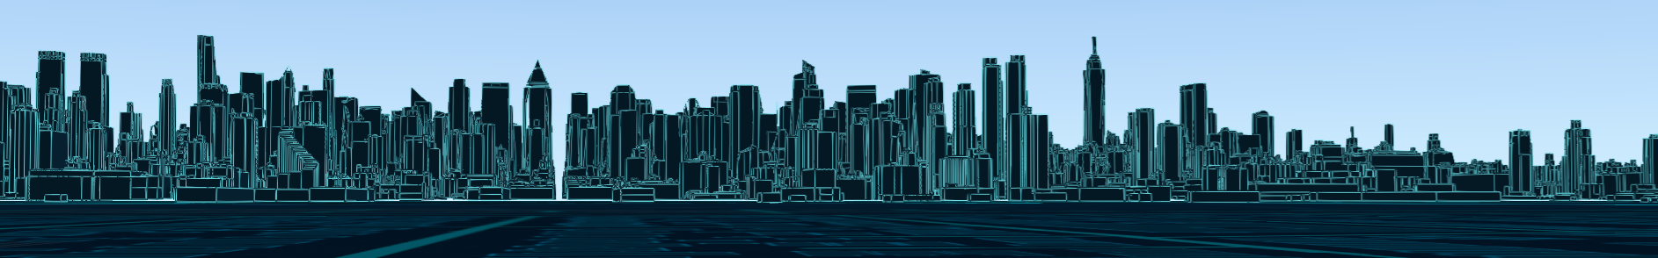

Slide 5
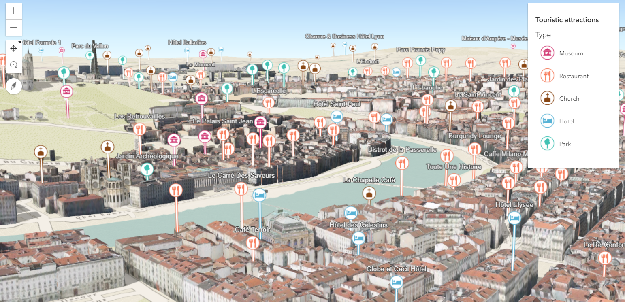
Points of interest in a city

Slide 6
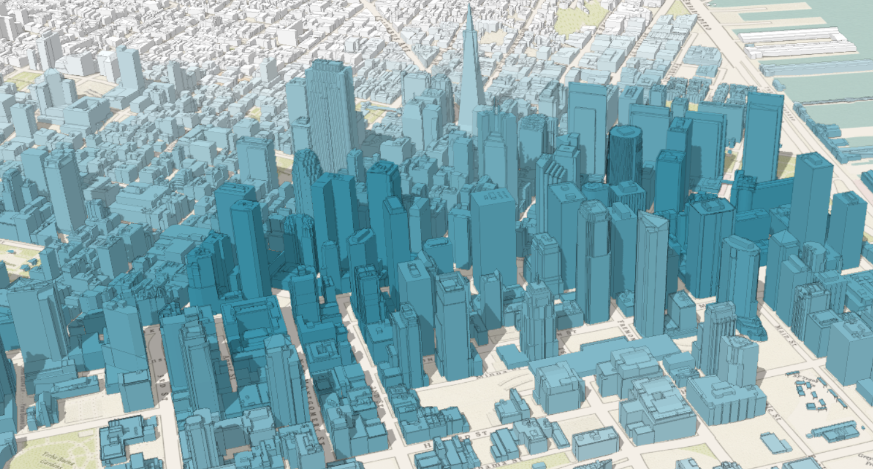
City thematic visualization

Slide 7
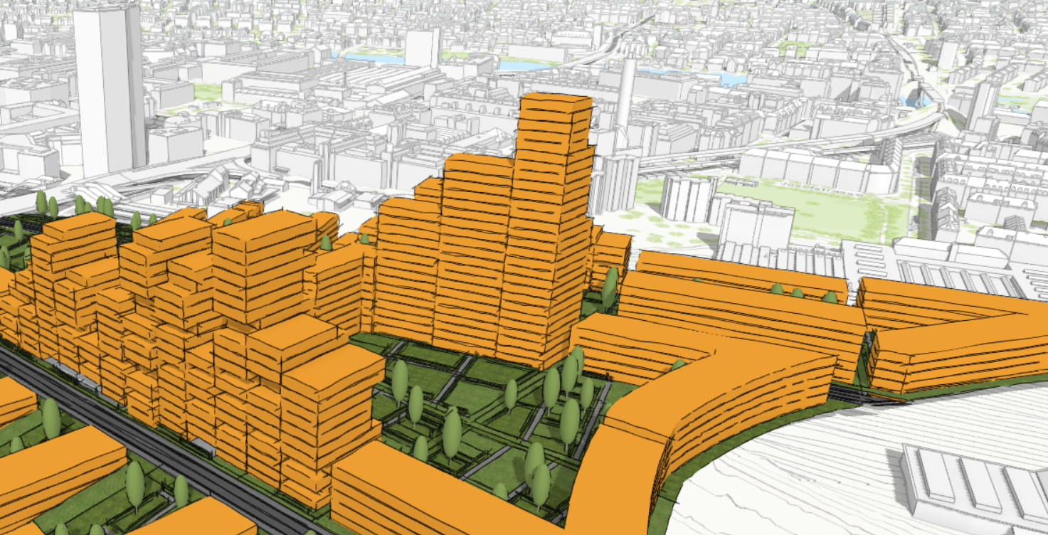
Urban Development

Slide 8


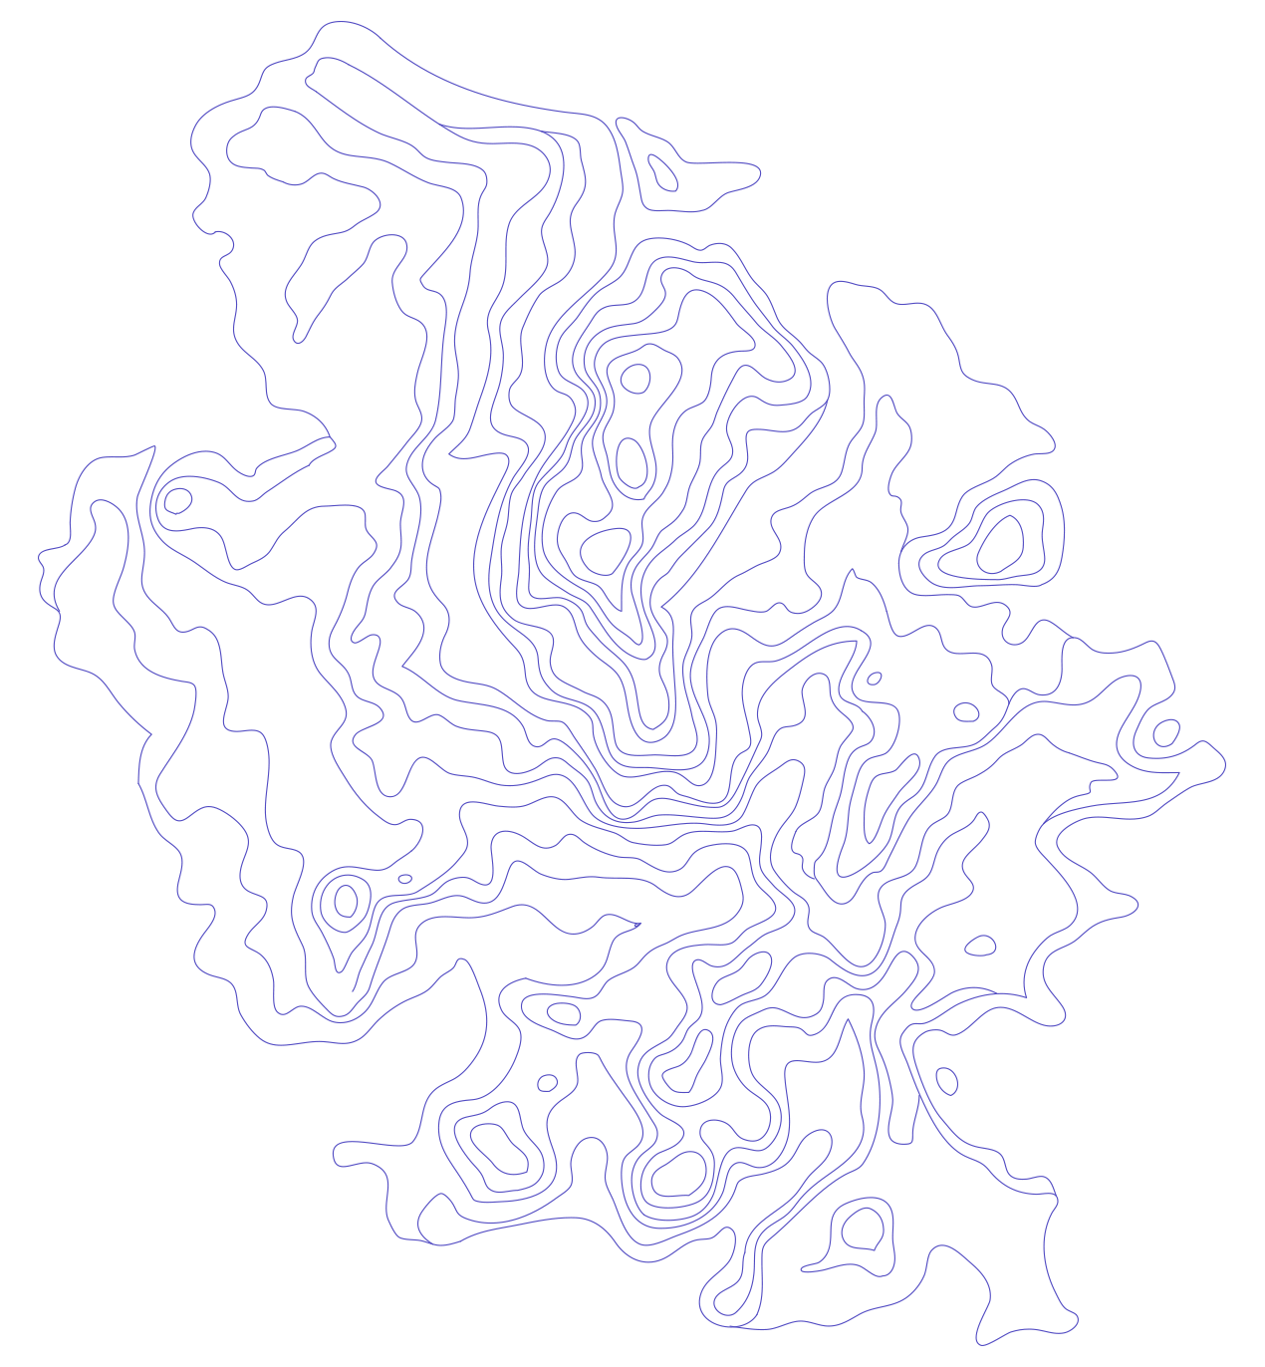


API Overview
renderers, symbols, symbol layers…
Notes:
G97350 UC Template for Esri staff

Slide 9
Data
FeatureLayer
MapImageLayer
SceneLayer
Includes 2D data sources
CSVLayer
PointCloudLayer
StreamLayer

Slide 10
Data-driven visualization
Renderers & Visual Variables
Field value(s) TOTAL_POP
Arcade expression Round( ($feature.BACHELOR + $feature.MASTER) / $feature.POP_25UP) );
JavaScript function function (graphic){ return graphic.attributes.POP_DENSITY; }

Slide 11
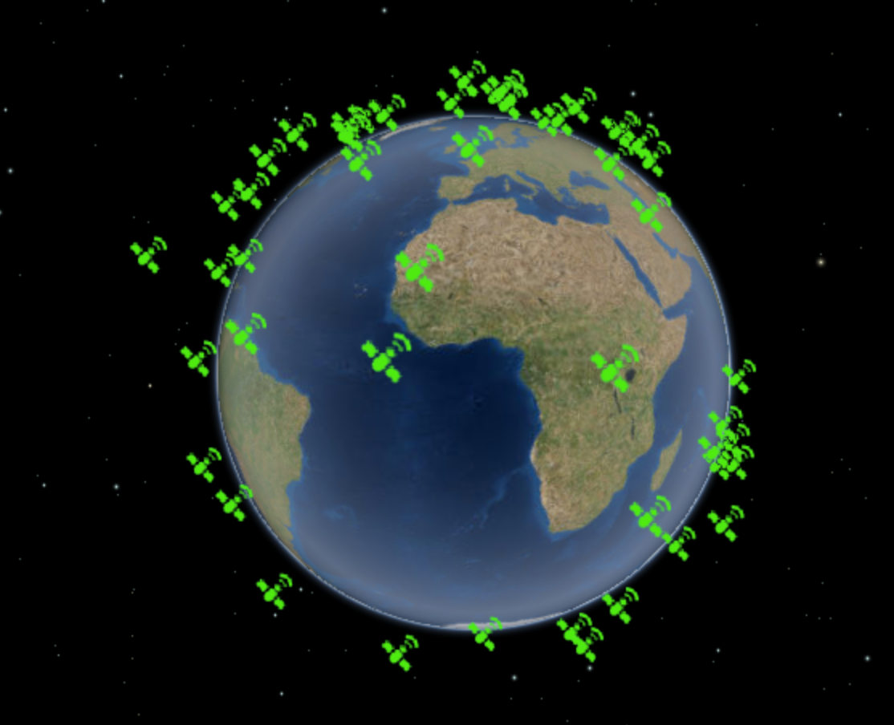
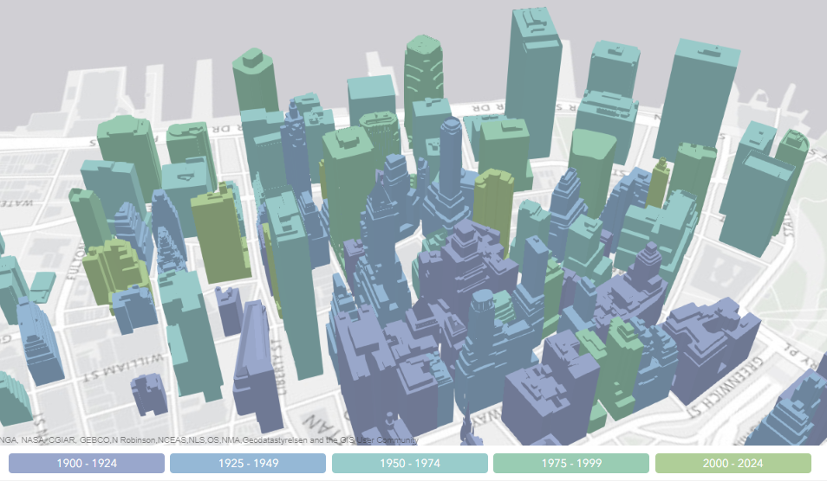
Renderers
SimpleRenderer
UniqueValueRenderer
ClassBreaksRenderer

Slide 12

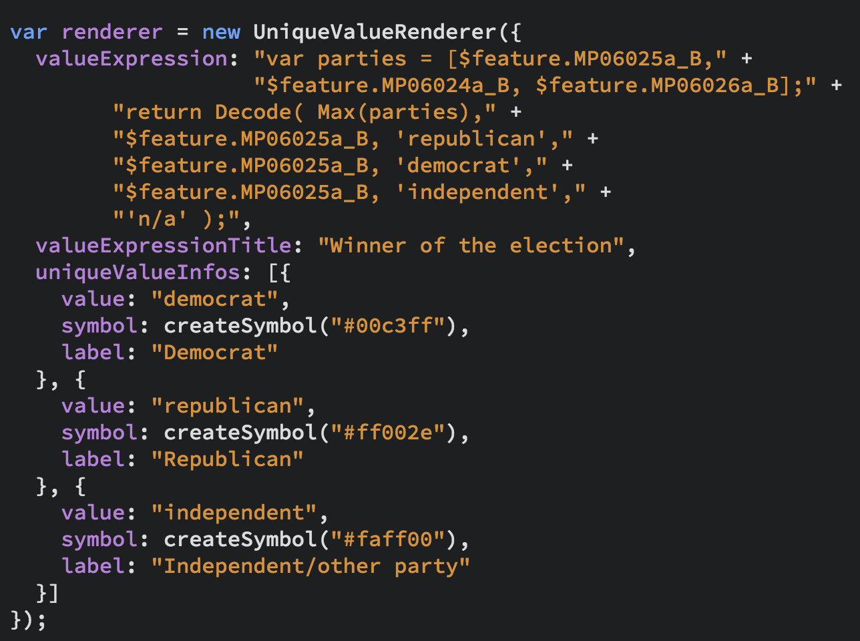
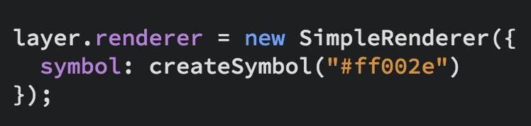
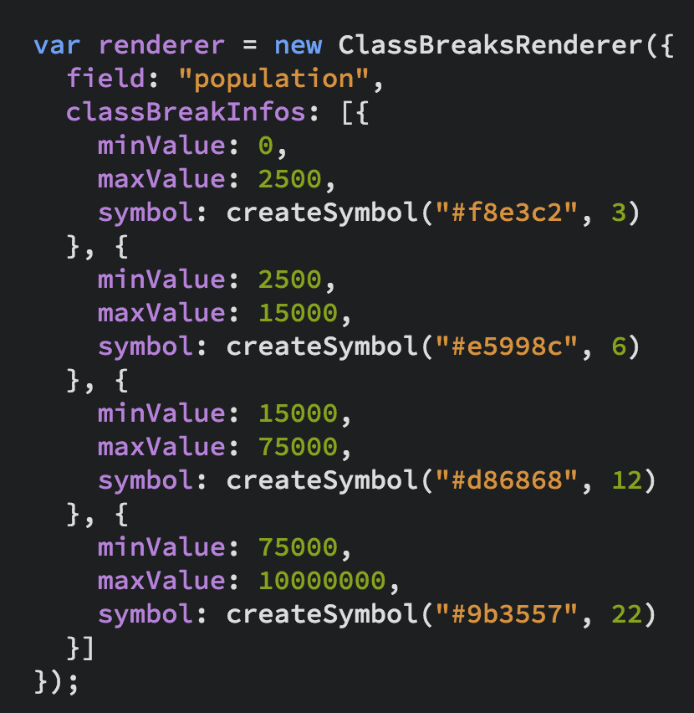
UniqueValueRenderer
Renderers
SimpleRenderer
ClassBreaksRenderer
…and PointCloud Renderers

Slide 13
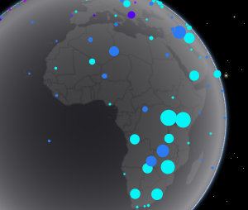
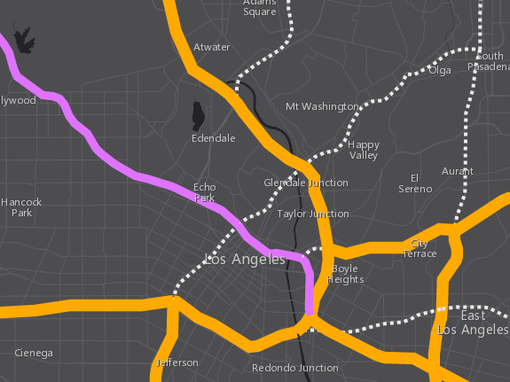
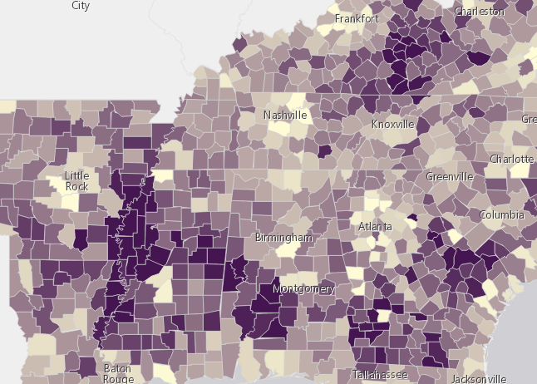
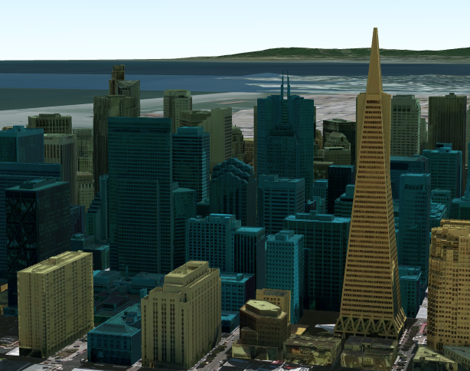
3D Symbols
based on geometry type
Points
Lines
Polygons
Mesh
PointSymbol3D
LineSymbol3D
PolygonSymbol3D
MeshSymbol3D

Slide 14
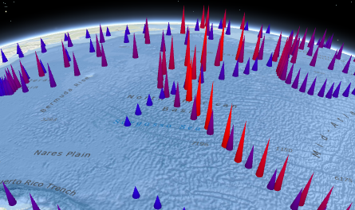
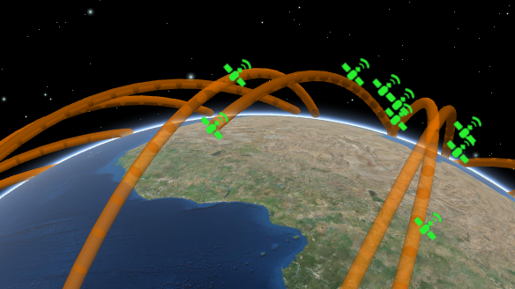
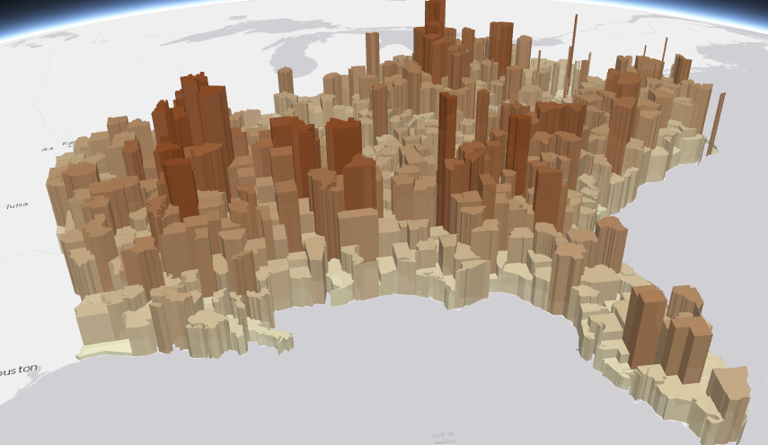
Symbols
PointSymbol3D
LineSymbol3D
PolygonSymbol3D
IconSymbol3DLayer
LineSymbol3DLayer
FillSymbol3DLayer
Flat
- Screen size units (pt, px)
- Graphics are in screen space
PathSymbol3DLayer
ExtrudeSymbol3DLayer
Volumetric
- Real world units (feet, meter)
- Graphics are in real world space
ObjectSymbol3DLayer

Slide 15
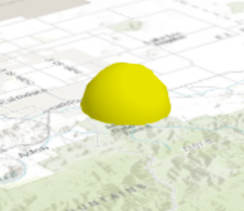
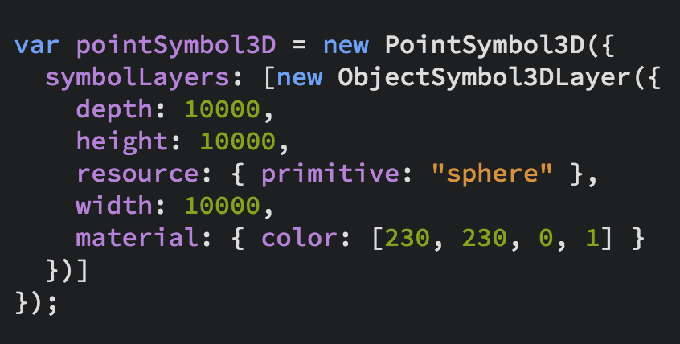
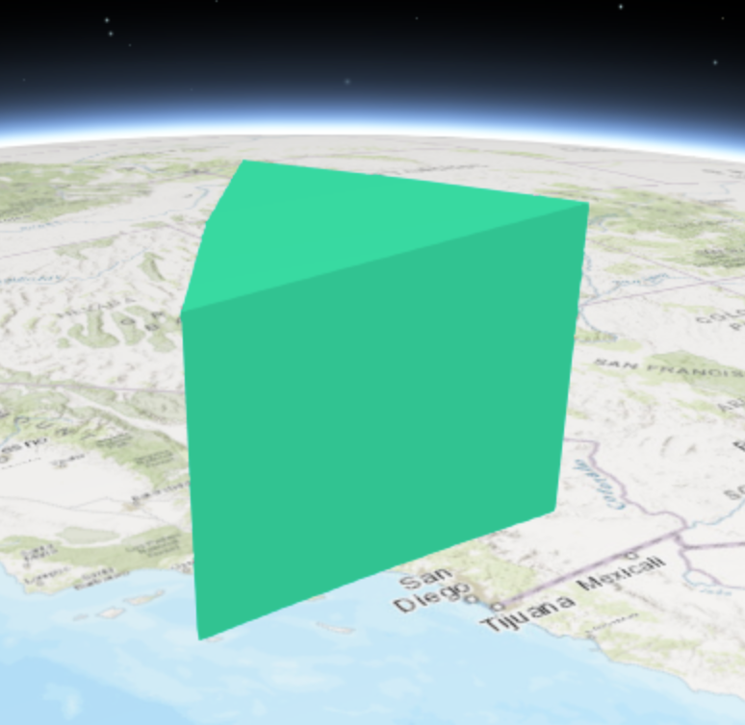
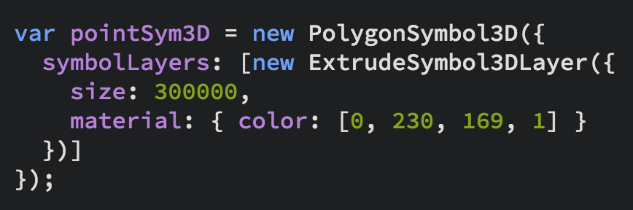
3D Symbols

Slide 16
layer
var layer = new FeatureLayer({
renderer: new SimpleRenderer({
symbol: new PointSymbol3D({
symbolLayers: [new IconSymbol3DLayer({…})]
})
}),
elevationInfo: {
mode: "relative-to-scene"
},
labelingInfo: [{
symbol: new LabelSymbol3D({
symbolLayers: [new TextSymbol3DLayer({…})]
})
}]
});
renderer
symbol
symbolLayers

Slide 17
var layer = new FeatureLayer({
renderer: new SimpleRenderer({
symbol: new PointSymbol3D({
symbolLayers: [new IconSymbol3DLayer({…})]
}),
visualVariables: [{
type: "size",
field: "TOTPOP_CY",
normalizationField: "SQMI",
stops: [{
value: 4000,
size: 6
},
{
value: 23000,
size: 40
}]
}]
});
renderer
symbol
symbolLayers
visualVariables
for numeric continuous visualizations

Slide 18
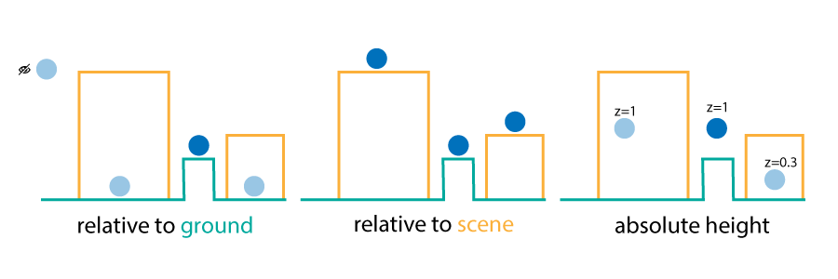
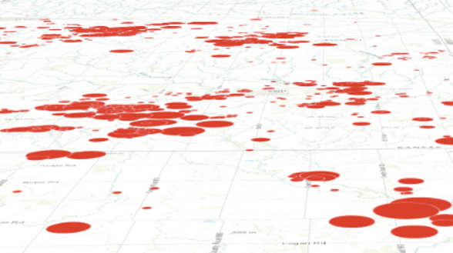
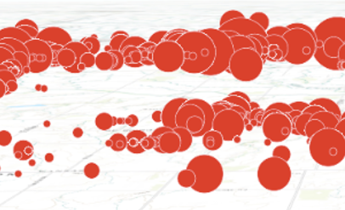
layer
elevationInfo
mode
on the ground
relative to ground

Slide 19
layer
var layer = new FeatureLayer({
renderer: new SimpleRenderer({
symbol: new PointSymbol3D({
symbolLayers: [new IconSymbol3DLayer({…})]
})
}),
elevationInfo: {
mode: "relative-to-scene"
},
labelingInfo: [{
symbol: new LabelSymbol3D({
symbolLayers: [new TextSymbol3DLayer({…})]
})
}]
});
elevationInfo
mode

Slide 20
layer
var layer = new FeatureLayer({
renderer: new SimpleRenderer({
symbol: new PointSymbol3D({
symbolLayers: [new IconSymbol3DLayer({…})]
})
}),
elevationInfo: {
mode: "relative-to-scene"
},
labelingInfo: [{
symbol: new LabelSymbol3D({
symbolLayers: [new TextSymbol3DLayer({…})]
})
}]
});
labelingInfo
symbol
symbolLayers

Slide 21
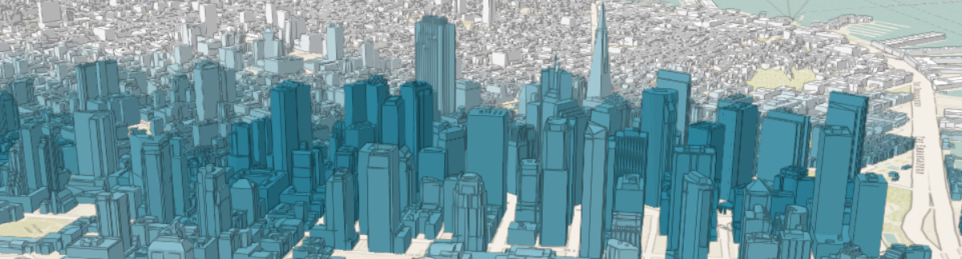
Symbols
MeshSymbol3D
FillSymbol3DLayer

Slide 22
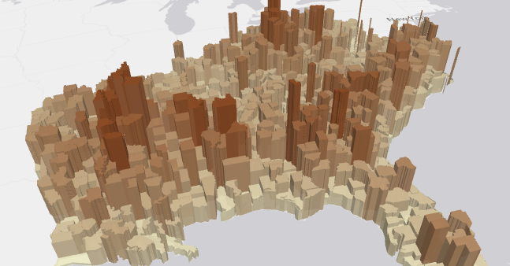
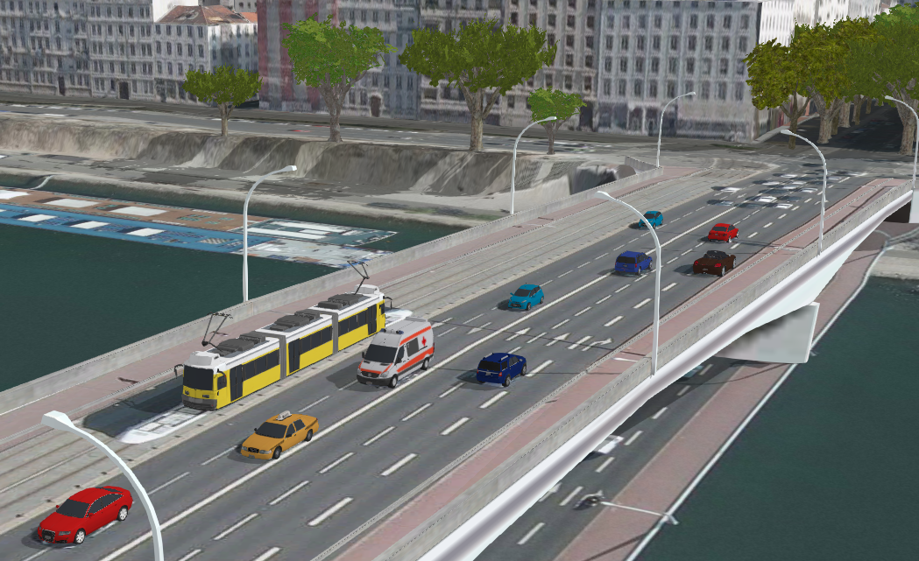
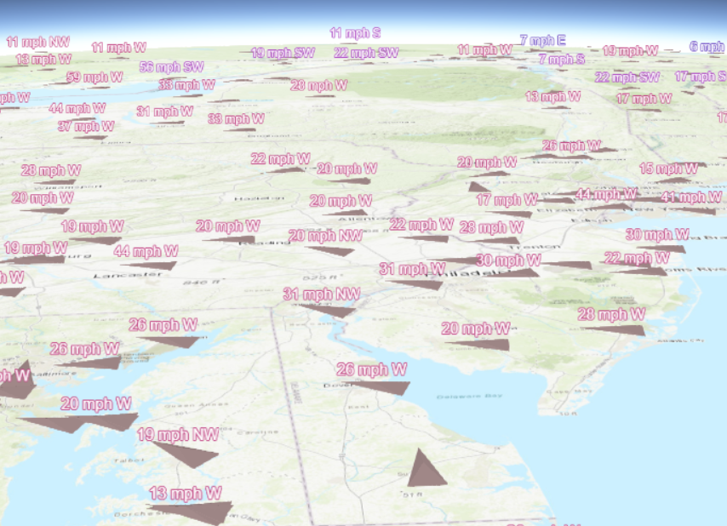
Multivariate mapping with visual variables
visualVariables - only for continuous numerical visualization
Color
Size
Rotation
Opacity

Slide 23
Examples
Notes:
G97350 UC Template for Esri staff

Slide 24

Demos

Slide 25
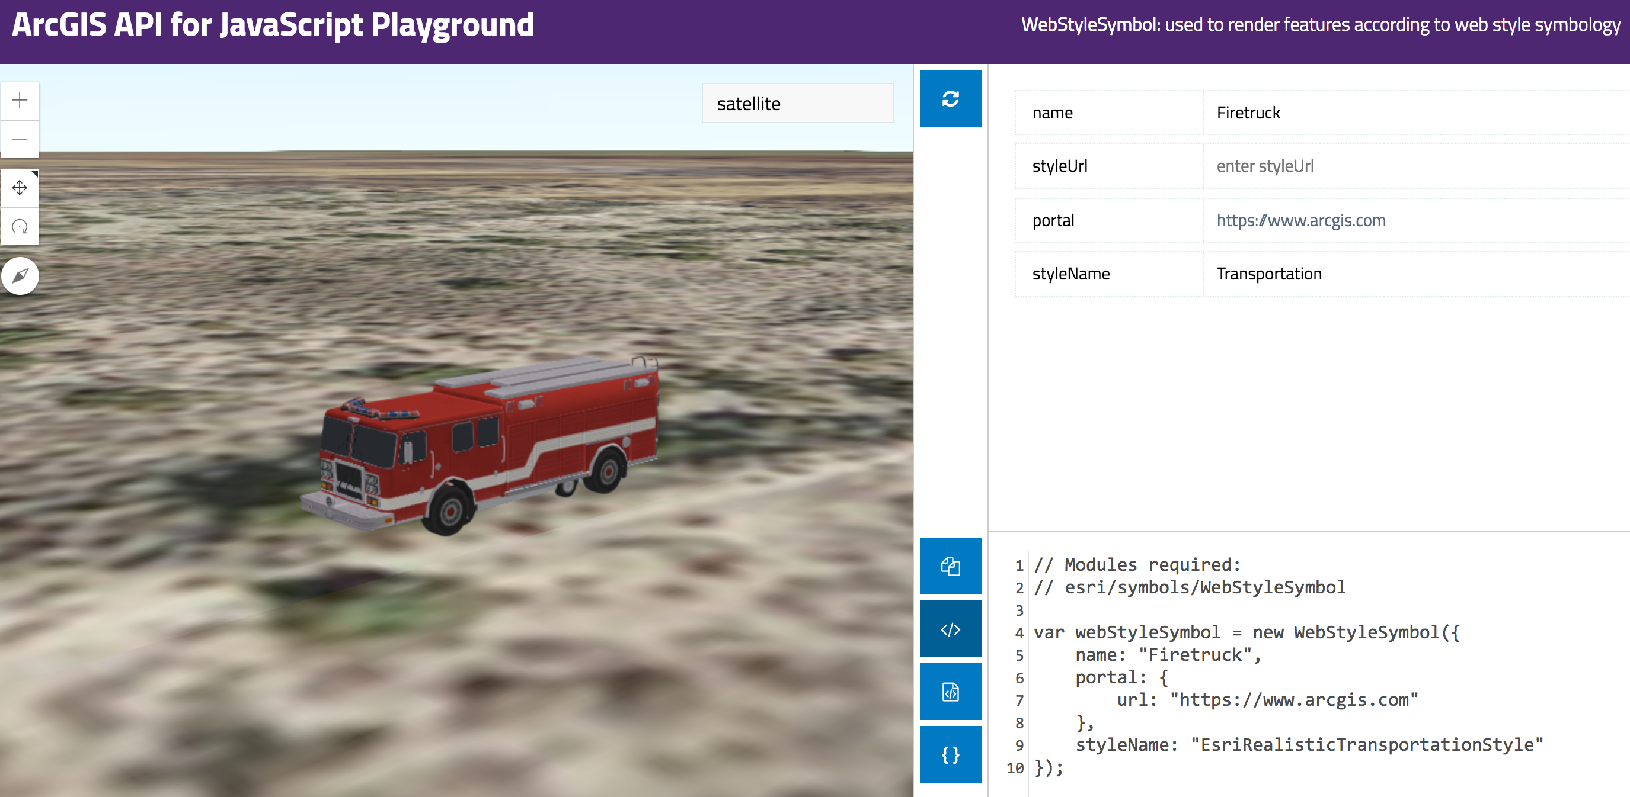
Resources
Get started with visualization
ArcGIS Blog
Icons, lines, fills
Objects, paths, extrusion
Real world sizes
Documentation
Renderer
Symbol3D
Symbol3DLayer

Slide 26

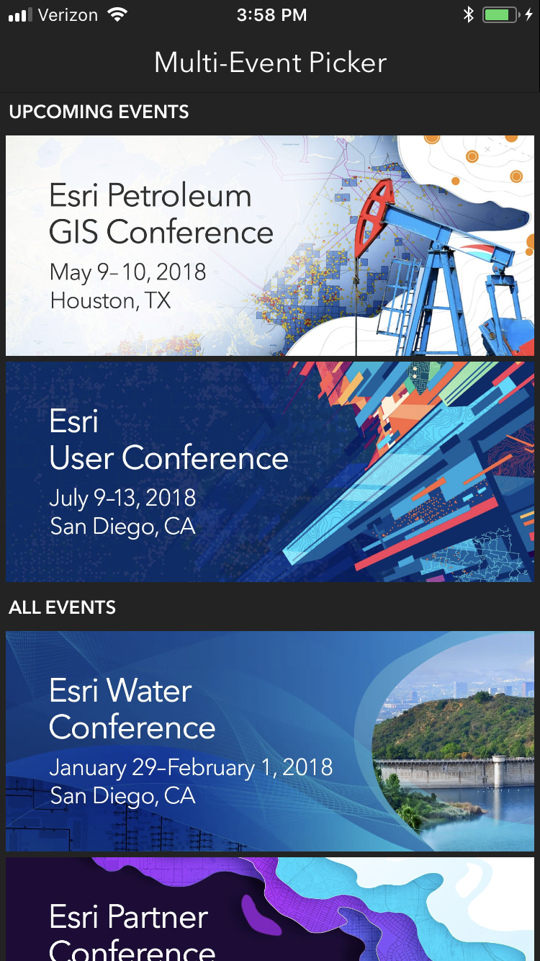
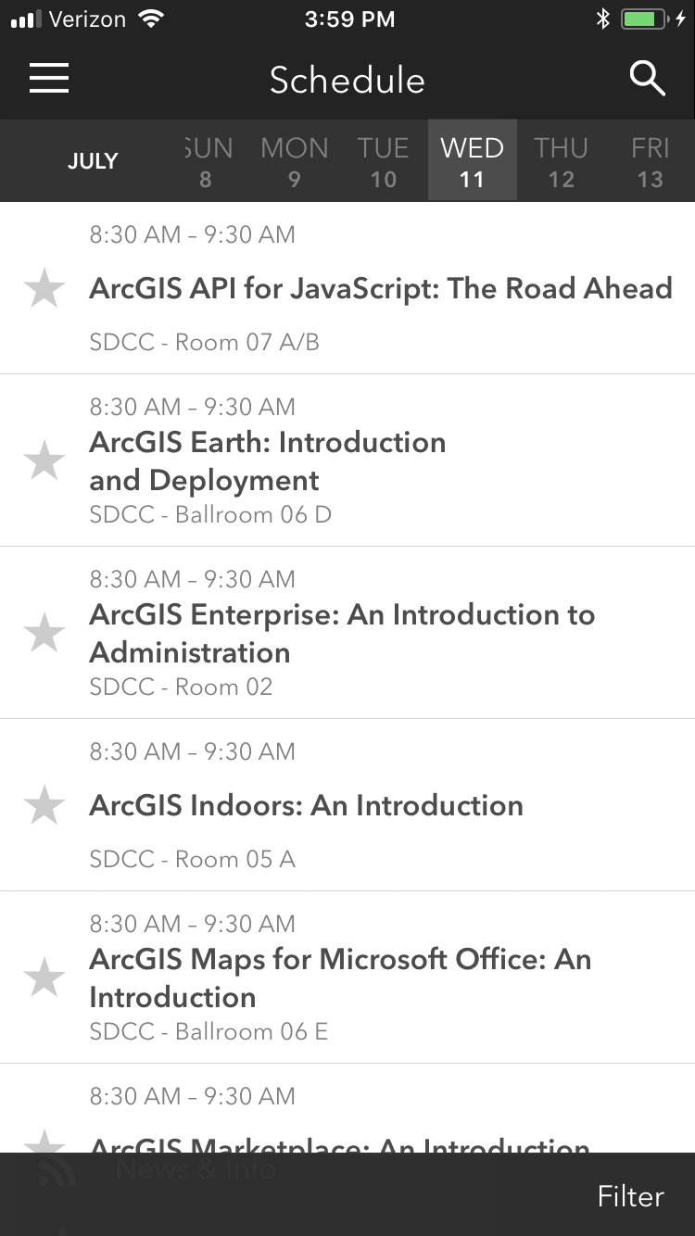
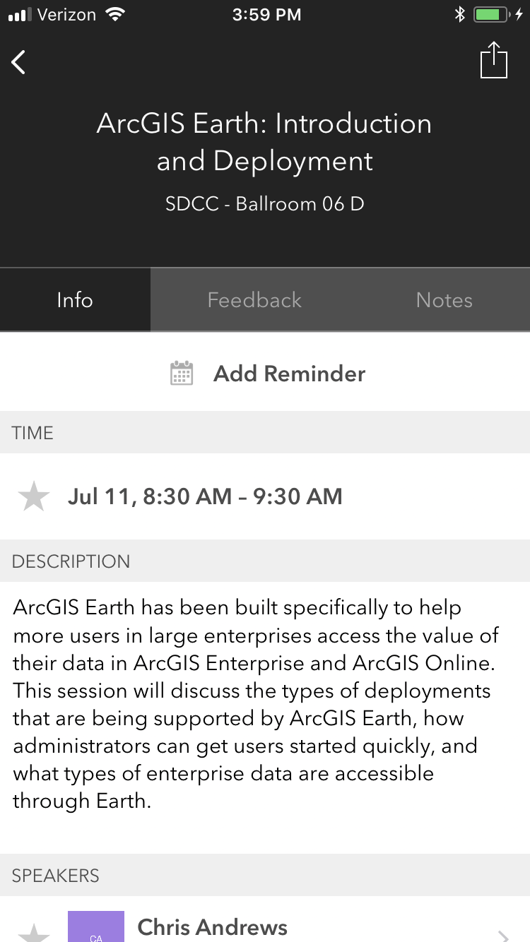
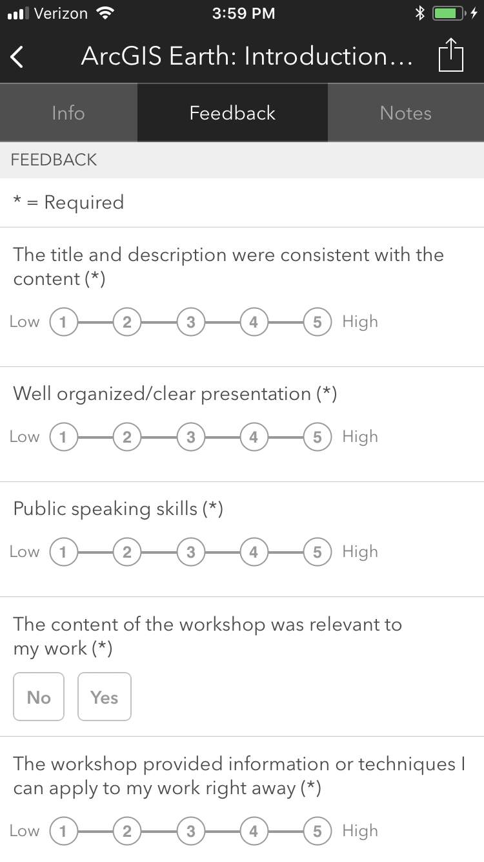


Please Take Our Survey on the App
Download the Esri Events app and find your event
Select the session you attended
Scroll down to find the feedback section
Complete answers
and select “Submit”

Slide 27
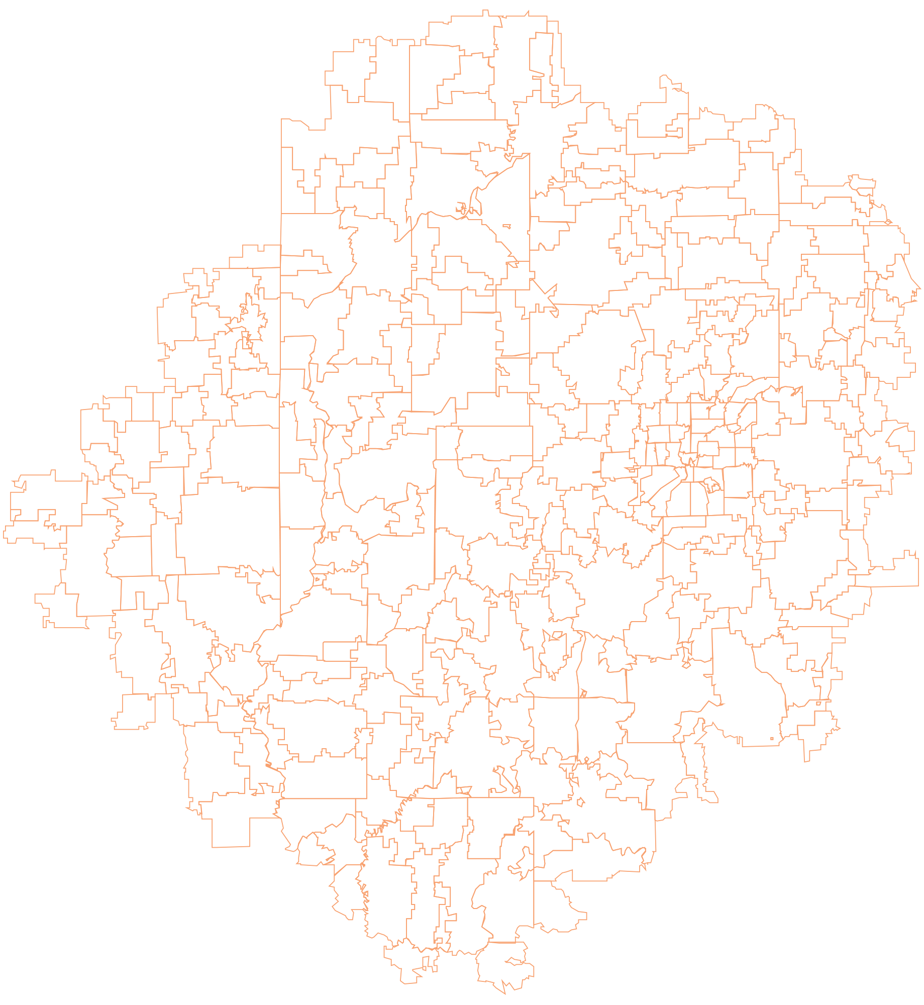


Notes:
G97350 UC Template for Esri staff

